Slide 1
St Cecilia Cyclone Bots
Coaches: Doug Roe, Erika Bayless
Students: Madeline R, Conor R, Elena G, Kyle G, Evan B, Max M, Anna R, Jackson B, Mackenzie B, Jack C, and Henry P.

Slide 2
The Rocket
The rocket will be powered by a biofuel reactor. It will be launched from a center and will use GPS to find the next. It will use SpaceX rocket landing tech and will be unloaded by robots, and loaded onto drones. They will then scan a QR code, telling it where to go, and how long it will take to reach the Destination. After the drone delivers, it goes back to the center and are charged by a solar battery.

Slide 3
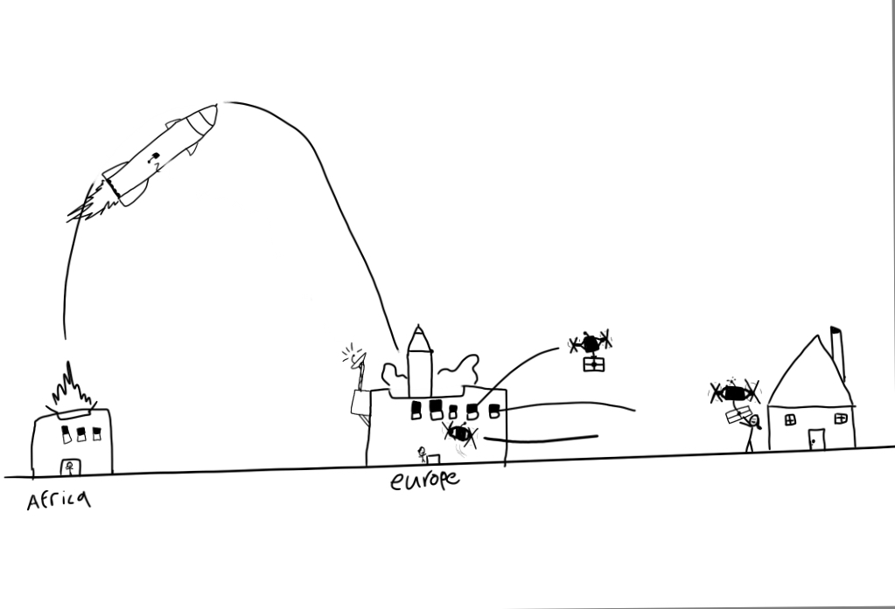
How the rocket will get from A-B-C

Slide 4
The Drones
The drones are powered by a anemometer on the drone, which spins when it is hit by wind, and powers a small generator.[solar power will also be used when the drone is docked] . They are controlled by humans, who work from home. The people who control the drone are basically playing a video game. However, the humans are working at the same time. The reason why humans control the drones is because they are aware of what is around them, so they know if there is birds or other drones they have to avoid. It will also help solve the job and supply problems.

Slide 5
How they are powered.
Rocket- it is powered by a separate thorium and tungsten reactor, which is safer and cleaner than an uranium reactor.
Drones- they are solar powered. They are also powered by the anemometer.

Slide 6
Challenges
The best distance for getting the robot from home to the platooning trucks is 14 -15 in
In the “Air Bud“ challenge, if the lever is pulled too slowly, the helicopter‘s package slides out the back instead of the front
In order for the wind turbine blade to rest completely on the stand, it has to be perfectly centered on said stand

